Slide 1
Write Up
32183641 / 이창윤

Slide 2
Q1) Given N numbers, write a code that sorts them in ascending order.
[Input]
- The first line of input contains the N (1≤N≤1000).
- Numbers are starting from the second line.
- This number is an integer whose absolute value is less than or equal to 1000.
- The numbers do not overlap.
[Output]
- Print the results sorted in ascending order from the first line to N lines; that is, one per line.
For this algorithm, I used https://visualgo.net/en/sorting?slide=1 which professor recommended. Quick Sort is the common way to sort the numbers, and I used this!

Slide 3
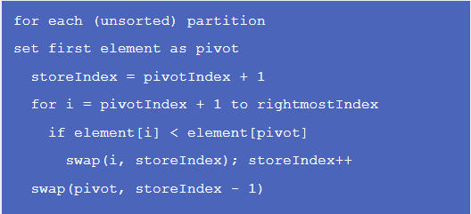
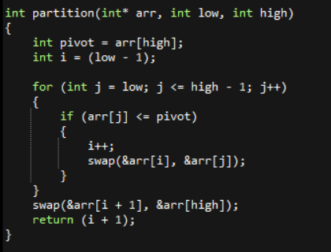
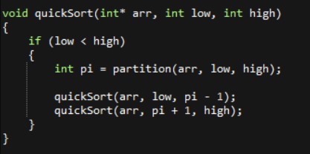
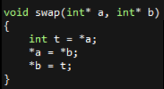
I referred this method, set pivot, partition, and made algorithms. Used recursion function in quickSort.

Slide 4
pivot -> Highest index
i -> low - 1
arr[j] <= pivot
i++
Swap arr[i] and arr[j]
Swap arr[i + 1] and arr[high]

Slide 5
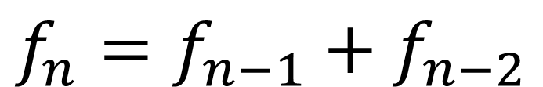
Q2) Fibonacci numbers start with 0 and 1. The 0th Fibonacci number is 0 and the 1st Fibonacci
number is 1. The following is the sum of the two previous Fibonacci numbers.
That is, F_{n}=F_{n-1}+ F_{n-2} (n≥2).
For example, when 2 ≤ n ≤ 17, Fibonacci numbers are,
0, 1, 1, 2, 3, 5, 8, 13, 21, 34, 55, 89, 144, 233, 377, 610, 987, 1597
When n is given, write a code to obtain the nth Fibonacci number.
[Input]
- n is given on the first line and the n is a natural number less than or equal to 45.
[Output]
Print the nth Fibonacci number in the first line.
This problem is famous. To make the Fibonacci algorithm, we have to think about the method.
$$f_{n}=f_{n−1}+f_{n−2}$$
Here is the method ->

Slide 6
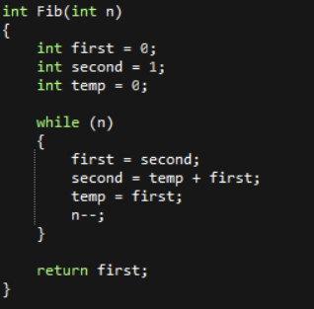
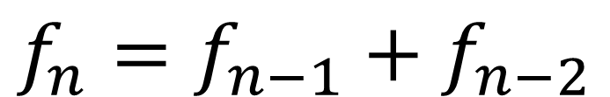
First = 0 -> 1 -> 1 -> 2 -> etc…
Temp = 0 -> 1 -> 1 -> etc…
Second = 1 -> 1 -> 2 -> 3 -> etc…
$$f_{n}=f_{n−1}+f_{n−2}$$
second
temp
first

Slide 7
Q3) When M and N are the natural numbers, select all of the prime numbers greater than or equal to M and less than or equal to N.
Write a code to find the sum and the minimum value of these prime numbers.
For example, in case of M=60 and N=100, the prime numbers are 61, 67, 71, 73, 79, 83, 89, 97.
Therefore, the sum of these prime numbers is 620, and the minimum value is 61.
[Input]
- M is given on the first line, and N is given on the second line.
- M and N are natural numbers less than 10,000 and M is equal to or less than N.
[Output]
Find all of the prime numbers greater than or equal to M and less than or equal to N,
and print the sum to the first line and the minimum value to the second line.
However, if there is no prime number greater than or equal to M and less than or equal to N, print -1 on the first line.
To make the sum and minimum of the prime number, I made functions that finds prime numbers between N and M, calculating the sum of them, and finding minimum number of them.

Slide 8
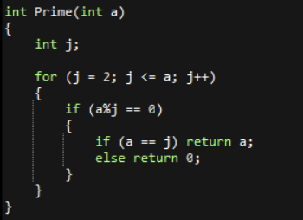
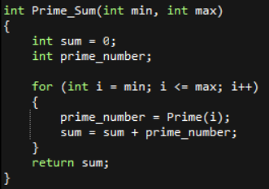
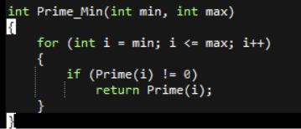
To find the prime numbers, I used sieve of Eratosthenes.
By using the function ‘Prime’, Set all the number to 0 except prime numbers.
Then, we can easily get the sum of prime numbers between N and M.
If we return multiple numbers in once, then the program returns only first one and ends it.

